Slide 1
Java Methods
Methods in java

Slide 2
Method
It is a individual block, to perform specific action
In java, a method is like function i.e. used to expose behavior of an object.
Methods are two types
1. predefined
2. user defined
Predefined method examples: length(), equals(), clone(), etc..;
User defined method examples: add(), sub(), sum(), displayStudentDetails(), searchStudent(), withDraw(), deposit(), transferAmount()

Slide 3
Advantage of Method
Code Reusability
Code Optimization (addition, subtraction, remove, search, sort, find operations)

Slide 4
Method Signature (Syntax) and Example
returntype methodname(parameter1, parameter2, …){ //parameters are optional
//method body
statemen1
statement2
}
Eg:
int add(int a, int b){
return a+ b;
}

Slide 5
Example
public class Addition {
int a = 10;
int b = 20;
Void add() { //user difined method
int c = a + b;
System.out.println("addition val: " + c);
}
public static void main(String[] args) {
Addition addition = new Addition();
addition.add();
}
}

Slide 6
Notes
void represents nothing to return
return is a keyword to return some value
Ex: return result;

Slide 7
Difference between parameter and argument?
Parameter is variable in the declaration of method.
Argument is the actual value of this variable that gets passed to method.
// Define a method with two parameters
int Sum(int num1, int num2)
{
return num1 + num2;
}
// Call the method using two arguments
int p = 29, q=30;
Sum(p,q); //p,q are arguments
Sum(2, 3); //2,3 are arguments

Slide 8
Method types based on return type and parameters
Method with out return type and without parameters
Method with return type and without parameters
Method with out return type and with parameters
Method with return type and with parameters

Slide 9
Method with out return type and without parameters
int a=10, b=20;
void add(){
int c = a+ b;
System.out.println("addition val: "+c);
}

Slide 10
Method with return type and without parameters
int a=10, b=20;
int add(){
int c = a+b;
return c;
}

Slide 11
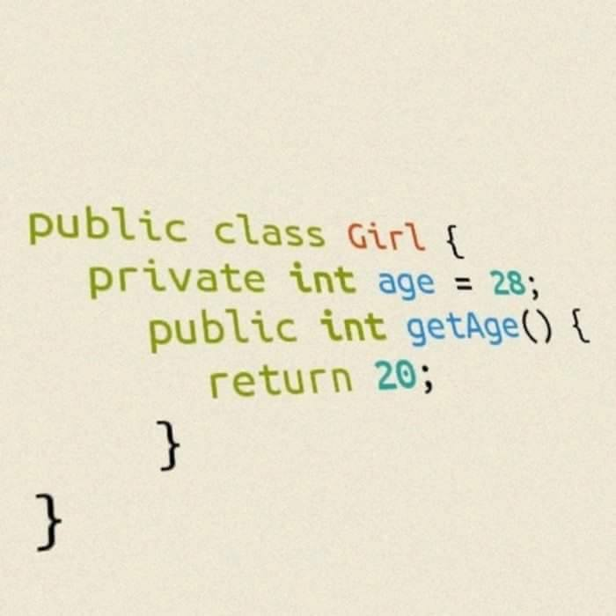
Funny program

Slide 12
Method without return type and with parameters
void add(int a, int b ){
int c = a+ b;
System.out.println("addition val: "+c);
}

Slide 13
Method with return type and with parameters
int add(int a, int b ){
int c = a+ b;
return c;
}

Slide 14
***Recursion
Java supports recursion.
Recursion is the process of defining something in terms of itself.
A method that calls itself is said to be recursive.

Slide 15
Print the name 3 times using recursion
public class RecursionDemo {
int counter = 0;
void printName(){
System.out.println("AMR");
counter++;
if(counter<3){
printName(); //recursion
}}
public static void main(String[] args) {
RecursionDemo r = new RecursionDemo();
r.printName();
}}

Slide 16
Can we call main method itself?
public static void main(String[] args) { //calling method
String[] name = null;
main(name); //recursion
}

Slide 17
Recursive method to find factorial of the given number
public class Test {
static int factorial(int n) {
if(n<0){
return -1;
}else if(n==0){
return 1;
}else{
return n*factorial(n-1);
} }
public static void main(String[] args) {
int n = 5;
System.out.println(factorial(n));
} }

Slide 18
Advantage of Recursion
Extremely useful when applying the same solution
A substitute for iteration where the iterative solution is very complex.
it reduces a time complexity of a program

Slide 19
Disadvantages with recursion
A recursive function is often confusing.
The exit point must be explicitly coded.
It is difficult to trace the logic of the function.
Every recursive call increases the stack size. It could potentially crash the stack and slow up the process.
It usually uses more memory for the stack.
It's usually slower due to the overhead of maintaining the stack.

